Slide 1
MySQL
Overview
By
Mohammed Mukthar Ahmed

Slide 2
Contents
MySQL Overview
What is in the name?
MySQL Dolphin
Main Features of MySQL
How Large MySQL Tables Can Be?
MySQL v/s Standard SQL
Connecting to MySQL Server
Disconnecting from MySQL Server
MySQL Prompt
Starting MySQL on Windows OS

Slide 3
MySQL AB
MySQL AB is the company of the MySQL founders and main developers.
MySQL AB was originally established in Sweden by David Axmark, Allan Larsson, and Michael “Monty” Widenius.
By the way, the “AB” part of the company name is the acronym for the Swedish “aktiebolag”, or “stock company”. It translates to “MySQL, Inc.”

Slide 4
MySQL Overview
MySQL, is the most popular Open Source SQL database management system, is developed, distributed, and supported by MySQL AB.
It is a Open Source company that unites Open Source values and methodology with a successful business model.

Slide 5
MySQL Overview
MySQL is a relational database management system.
MySQL software is Open Source.
The MySQL Database Server is very fast, reliable, and easy to use.
MySQL Server works in client/server or embedded systems.
The official way to pronounce “MySQL” is “My Ess Que Ell” (not “my sequel”).

Slide 6
What’s in the name?
The derivation of the name MySQL is not clear.
Our base directory and a large number of our libraries and tools have had the prefix “my”.
Co-founder Monty Widenius's daughter is also named My.
Which of the two gave its name to MySQL is still a mystery.

Slide 7
MySQL Dolphin
The name of the MySQL Dolphin (our logo) is “Sakila,” which was chosen by the founders of MySQL AB from a huge list of names suggested by users in our “Name the Dolphin” contest.
The winning name was submitted by Ambrose Twebaze, an Open Source software developer.

Slide 8
Main Features of MySQL
The following list describes some of the important characteristics of the MySQL Database Software.
Internals and Portability.
  Written in C and C++.
  Tested with a broad range of different compilers.
  Works on many different platforms.
  Uses GNU Automake, Autoconf, and Libtool for portability.
  APIs for C, C++, Eiffel, Java, Perl, PHP, Python, Ruby, and Tcl are available.

Slide 9
Main Features of MySQL
Internals and Portability.
  Fully multi-threaded using kernel threads. It can easily use multiple CPUs if they are available.
  Provides transactional and non-transactional storage engines.
  Uses very fast B-tree disk tables (MyISAM) with index compression.
  Relatively easy to add other storage engines. This is useful if you want to add an SQL interface to an in-house database.
  A very fast thread-based memory allocation system.
  Very fast joins using an optimized multi-join.

Slide 10
Main Features of MySQL
Internals and Portability.
  In-memory hash tables, which are used as temporary tables.
  SQL functions are implemented using a highly optimized class library and should be as fast as possible. Usually there is no memory allocation at all after query initialization.
  The MySQL code is tested with Purify (a commercial memory leakage detector) as well as with Valgrind, a GPL tool.

Slide 11
Main Features of MySQL
Data Types
  Many data types: signed/unsigned integers 1, 2, 3, 4, and 8 bytes long, FLOAT, DOUBLE, CHAR, VARCHAR, TEXT, BLOB, DATE, TIME, DATETIME, TIMESTAMP, YEAR, SET, and ENUM types.
  Fixed-length and variable-length records.

Slide 12
Main Features of MySQL
Statements and Functions
  Full operator and function support in the SELECT and WHERE clauses of queries.
  Full support for SQL GROUP BY and ORDER BY clauses. Support for group functions.
  Support for LEFT OUTER JOIN and RIGHT OUTER JOIN with both standard SQL and ODBC syntax.
  Support for aliases on tables and columns as required by standard SQL

Slide 13
Main Features of MySQL
Statements and Functions
  DELETE, INSERT, REPLACE, and UPDATE return the number of rows that were changed (affected).
  The MySQL-specific SHOW statement can be used to retrieve information about databases, storage engines, tables, and indexes.
  The EXPLAIN statement can be used to determine how the optimizer resolves a query.

Slide 14
Main Features of MySQL
Statements and Functions
  You can mix tables from different databases in the same query.
Security
  A privilege and password system that is very flexible and secure, and that allows host-based verification.
  Passwords are secure because all password traffic is encrypted when you connect to a server.

Slide 15
Main Features of MySQL
Scalability and Limits
  Handles large databases.
  We use MySQL Server with databases that contain 50 million records.
  We also know of users who use MySQL Server with 60,000 tables and about 5,000,000,000 rows.
  Up to 64 indexes per table are allowed (32 before MySQL 4.1.2).

Slide 16
Main Features of MySQL
Scalability and Limits
  Up to 64 indexes per table are allowed (32 before MySQL 4.1.2).
  Each index may consist of 1 to 16 columns or parts of columns.
  The maximum index width is 1000 bytes (767 for InnoDB); before MySQL 4.1.2, the limit is 500 bytes.

Slide 17
Main Features of MySQL
Connectivity
  Clients can connect to the MySQL server using TCP/IP sockets on any platform.
  In MySQL 4.1 and higher, Windows servers also support shared-memory connections.
  The Connector/ODBC (MyODBC) interface provides MySQL support for client programs that use ODBC (Open Database Connectivity) connections.

Slide 18
Main Features of MySQL
Connectivity
  The Connector/J interface provides MySQL support for Java client programs that use JDBC connections.
  MySQL Connector/NET enables developers to easily create .NET applications that require secure, high-performance data connectivity with MySQL.

Slide 19
Main Features of MySQL
Localization
  The server can provide error messages to clients in many languages.
  Unicode support is available as of MySQL 4.1.
  All data is saved in the chosen character set. All comparisons for normal string columns are case-insensitive.
  Sorting is done according to the chosen character set

Slide 20
Main Features of MySQL
Clients and Tools
  MySQL Server has built-in support for SQL statements to check, optimize, and repair tables.
  These statements are available from the command line through the mysqlcheck client. MySQL also includes myisamchk, a very fast command-line utility for performing these operations on MyISAM tables.

Slide 21
How Large MySQL Tables Can Be?
MySQL 3.22 had a 4GB (4 gigabyte) limit on table size.
With the MyISAM storage engine in MySQL 3.23, the maximum table size was increased to 65536 terabytes (256⁷ – 1 bytes).
However, the table size also depends on the operating system. The following table illustrate that.

Slide 22
How Large MySQL Tables Can Be?
However, the table size also depends on the operating system. The following table illustrate that.
Operating System | File-size Limit
Linux 2.4+ | (using ext3 filesystem) 4TB
Solaris 9/10 | 16TB
Win32 w/ FAT/FAT32 | 2GB/4GB
Win32 w/ NTFS | 2TB
MacOS X w/ HFS+ | 2TB

Slide 23
Year 2000 Compliance
The MySQL Server itself has no problems with Year 2000 (Y2K) compliance.

Slide 24
MySQL v/s Standard SQL
MySQL Server follow the ANSI SQL standard and the ODBC SQL standard, but MySQL Server performs operations differently in some cases:
  For VARCHAR columns, trailing spaces are removed when the value is stored.
  CHAR columns are silently converted to VARCHAR columns when you define a table or alter its structure.

Slide 25
MySQL v/s Standard SQL
MySQL v/s Standard SQL
  MySQL, privileges for a table are not automatically revoked when you delete a table. You must explicitly issue a REVOKE statement to revoke privileges for a table.
  The CAST() function does not support cast to REAL or BIGINT.

Slide 26
Connecting to MySQL Server
To connect to the server, you will usually need to provide a MySQL user name when you invoke mysql and, most likely, a password.
If the server runs on a machine other than the one where you log in, you will also need to specify a host name.

Slide 27
Connecting to MySQL Server
Once you know the proper parameters, you should be able to connect like this:
shell> mysql –h host –u user –p
Enter password: *******
Welcome to the MySQL monitor. Commands end with ; or \g. Your MySQL connection id is 26 to server version: 4.1.22
Type 'help;' or '\h' for help. Type '\c' to clear the buffer.
mysql>

Slide 28
Disconnecting from MySQL Server
After you have connected successfully, you can disconnect any time by typing QUIT (or \q) at the mysql> prompt:
mysql> Quit
Bye
On Unix/Linux, you can also disconnect by pressing Control-D.

Slide 29
MySQL Prompt
A command normally consists of an SQL statement followed by a semicolon or \g.
It can be split across multiple lines.
If you decide you do not want to execute a command that you are in the process of entering, cancel it by typing \c.
If you decide you do not want to execute a command that you are in the process of entering, but quit type \q.

Slide 30
MySQL Prompt
Table shows each of the prompts you may see and summarizes what they mean about the state that mysql is in:
Prompt | Meaning
mysql> | Ready for new command
-> | Waiting for next line of multiple-line command.
‘ > | Waiting for next line, waiting for completion of a string that began with a single quote (‘'’).
“ > | Waiting for next line, waiting for completion of a string that began with a double quote (‘"’).
` > | Waiting for next line, waiting for completion of an identifier that began with a backtick (‘`’).
/* > | Waiting for next line, waiting for completion of a comment that began with /*.

Slide 31
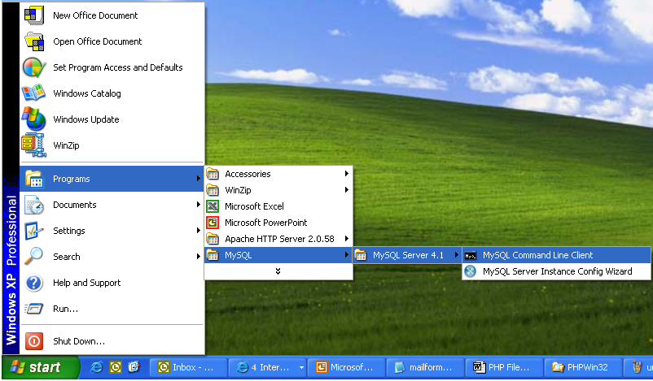
Starting MySQL on Windows
To start MySQL on Windows, choose “MySQL Command Line Client” from MySQL Server 4.1 as shown below:

Slide 32
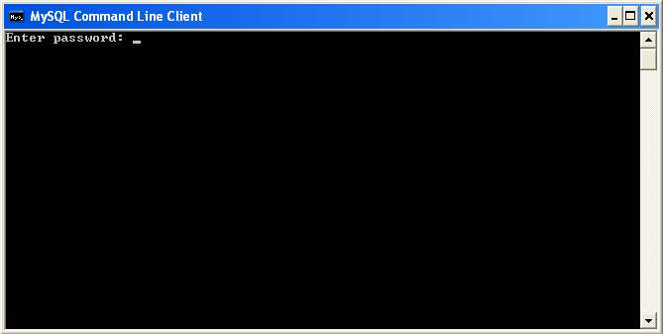
Starting MySQL on Windows
The MySQL Command Line Client window will be displayed as shown below:
Enter the password

Slide 33
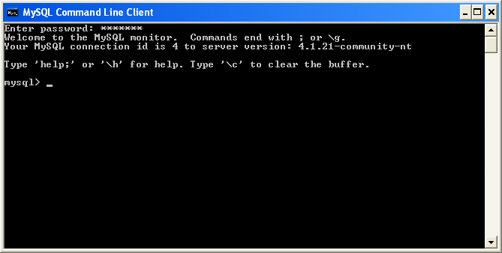
Starting MySQL on Windows
On Entering the password, the screen looks as shown below:

Slide 34
Ending MySQL Session
Now, we can issue MySQL commands.
Once you're done you can end mysql client by typing quit or exit at the mysql> prompt.

